Slide 1
Rhode Island Core Curriculum Reviews
[This slide deck is meant to serve as a turn-key tool for educators to share with their teams whether at the LEA or school level. It can be used to help with understanding of and planning for the implementation of the Social Studies Standards if it is determined that a school or LEA needs to consider new curricular materials for social studies. There is also a recorded version of this presentation available. See notes sections for talking points.]

Slide 2
Agenda
High-Quality Curriculum Materials in Social Studies
State Review Process
Review Reports

Slide 3
What the State Reviews Are and Are Not
Reviews:
help LEAs make curriculum adoption decisions as they implement the new Social Studies Standards
are NOT a “green light” list. LEAs are not required to select materials that have been reviewed through RIDE’s review process
Notes:
In 2023, the Rhode Island Department of Education published the revised Rhode Island Social Studies Standards which are grade level specific and are a change from the previous Grade Span Expectations. In addition, the new Social Studies Curriculum Framework, published in early 2024, identifies what high quality curriculum should look like in social studies. New content and expectations of high quality prompted the need for Rhode Island’s Local Education Agencies (LEAs) to review existing instructional materials for standards alignment and quality or to adopt new materials.
In Rhode Island, LEAs purchase instructional materials that are best for their local communities since those closest to students are best positioned to decide which instructional materials are appropriate for their district and classrooms. To support LEAs in making their decisions, RIDE conducted core curriculum reviews based on criteria outlined in the Social Studies Curriculum Framework, which will be covered in this presentation.
Rhode Island legislation (RIGL§ 16-22-32) requires that LEAs adopt high quality curriculum materials in English language arts, mathematics, and science and technology, primarily using curriculum reviewed by EdReports. This law does not name social studies and therefore the materials posted are not a “green light” list. LEAs are not required to select materials that have been reviewed through RIDE’s review process.

Slide 4
High-Quality Curriculum in Social Studies
The Social Studies Curriculum Framework outlines criteria for HQCM in social studies
HQCMs should align to the Rhode Island Social Studies Standards by:
Including instructional materials that connect to the principles as outlined by the social studies anchor standards.
Including content that aligns to the social studies content standards that are specific by grade and high school course and include content required by legislation.
Emphasizing culturally responsive and sustaining education (CRSE) principles and practices by supporting equitable representations and disrupting cultural norms and biases to meet the needs of every student within the educational space.
Notes:
Though social studies materials are not named in the legislation, it is expected that LEAs adopt high quality curriculum for all the core subjects, including social studies. EdReports, mentioned in the previous slide, does not review social studies curricula, therefore, RIDE has developed criteria for recognizing high-quality curriculum in social studies.
The Social Studies Curriculum Framework outlines the criteria as those that align to the Rhode Island Social Studies Standards by…
Including instructional materials that connect to the principles as outlined by the social studies anchor standards.
Including content that aligns to the social studies content standards that are specific by grade and high school course and include content required by legislation.
Emphasizing culturally responsive and sustaining education (CRSE) principles and practices by supporting equitable representations and disrupting cultural norms and biases to meet the needs of every student within the educational space.

Slide 5
High-Quality Curriculum in Social Studies
HQCMs should align to the Rhode Island Social Studies Standards by
Emphasizing academic rigor as outlined in the Standards, allowing students to identify, explain, and analyze content and make evidence-based arguments.
Developing students’ civic skills and dispositions.
Fostering an inquiry-based learning environment and engaging students in grade-appropriate historical inquiry and analysis.
Notes:
Emphasizing academic rigor as outlined in the Standards, allowing students to identify, explain, and analyze content and make evidence-based arguments.
Developing students’ civic skills and dispositions.
Fostering an inquiry-based learning environment and engaging students in grade-appropriate historical inquiry and analysis.

Slide 6
High-Quality Curriculum in Social Studies
HQCMs should align to evidence-based best practices by
Including authentic primary sources and a variety of secondary sources that reflect a range of perspectives and experiences that will allow students to think critically as they identify, explain, and analyze content and make evidence-based arguments.
Providing avenues for facilitating discussions of current events that allow students to draw connections between issues of the past and issues today.
Including grade-level appropriate text that builds reading, writing, speaking, and listening skills through social studies content.
Including supports for multilingual learners (MLLs) and differently-abled students (DAS).
Notes:
The Curriculum Framework also outlines criteria that align to evidence-based best practices in social studies such as…
Including authentic primary sources and a variety of secondary sources that reflect a range of perspectives and experiences that will allow students to think critically as they identify, explain, and analyze content and make evidence-based arguments.
Providing avenues for facilitating discussions of current events that allow students to draw connections between issues of the past and issues today.
Including grade-level appropriate text that builds reading, writing, speaking, and listening skills through social studies content.
Including supports for multilingual learners (MLLs) and differently-abled students (DAS).
More criteria for this category are listed in the Curriculum Framework.

Slide 7
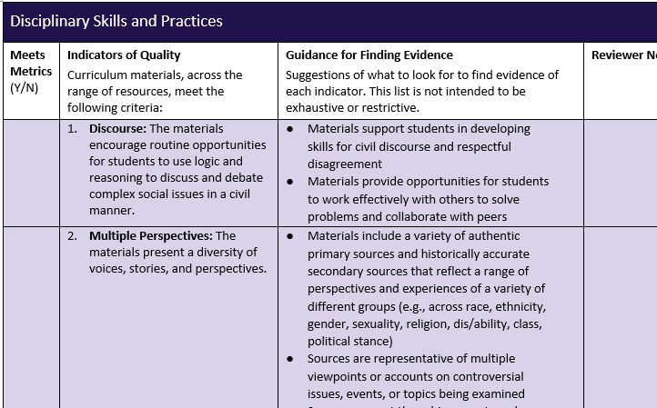
High-Quality Curriculum in Social Studies
Selecting HQCMs for Social Studies
Rhode Island Social Studies Review Tool for Selecting High-Quality Curriculum Materials
Rhode Island Guide for Assessing Curriculum Materials in Social Studies for High-Quality
For Reviewing core and supplemental instructional materials
Notes:
RIDE took all of these criteria and created a Review Tool for selecting high-quality materials in social studies and a review protocol.
[Show where these live on the website. Note that the Review Tool is available as PDF or as a fillable Google Document]
LEAs are invited to use these tools when reviewing curricula they are considering for adoption. It is suggested that schools or LEAs conduct their own reviews of curricula on RIDE’s review list.

Slide 8
High-Quality Curriculum in Social Studies
Core and Supplemental Materials
Core instructional materials are the comprehensive print or digital educational material, including basal material, which constitute the necessary instructional components of a full academic course of study.
Supplementary instructional materials are used to reinforce, enrich, or enhance Instruction driven by core instructional material.
Definitions adapted from New Mexico’s instructional materials legislation 6.75.2.7 C and W
Notes:
Core instructional materials are the comprehensive print or digital educational material, including basal material, which constitute the necessary instructional components of a full academic course of study.
Supplementary instructional materials are used to reinforce, enrich, or enhance Instruction driven by core instructional material.
Though the Review Tool can be used for both core and supplemental materials, RIDE’s reviews focused on identifying core instructional materials for consideration by districts.

Slide 9
Review Timeline
Project Phases |  | Summer 2023 | Fall 2023 | Winter 2024 | Spring 2024 | Summer 2024
Phase 1 Grade 8 and HS Courses | Request for Curriculum
 | Review Team Work
Phase 2 Grades 5, 6, and 7 | Request for Curriculum
 | Review Team Work
Phase 3 Kinder to Grade 4 | Request for Curriculum
 | Review Team Work
Reviews Published
Notes:
The review project was split into three phases.
Phase 1 consisted of the review of materials for grade 8 and the five high school courses represented in the Social Studies Standards.
Phase 2 was for grades 5, 6, and 7, and
Phase 3 included Kindergarten to grade 4.
For each phase, there was a round of requesting curriculum submissions from publishers/vendors and a round of recruiting and training review teams plus the work of the review teams. RIDE began phase 1 in the early part of the summer 2023 and reviews were published to the website in late summer 2024.

Slide 10
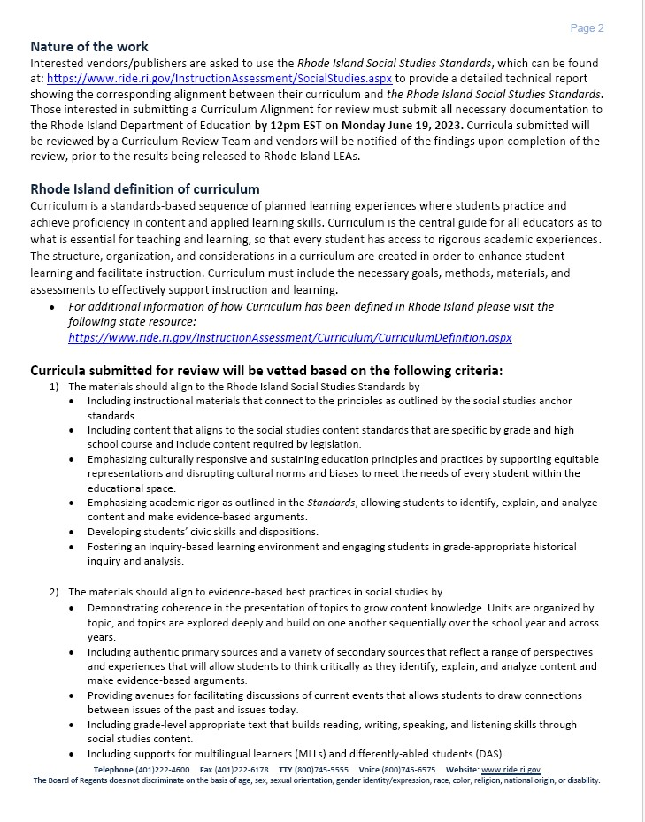
Request for Curriculum
Criteria outlined in the Social Studies Curriculum Framework were repeated in the call to publishers
The request was forwarded to publishers based on a scan of publishers of core social studies curricula completed by CCSSO in 2019
The request was also posted in the Social Studies Newsletter, RIDE’s Field Memo, and RIDE’s website
Notes:
For each phase, a Request for Curriculum was posted. When soliciting vendors for curricular submissions, the Review Tool had not yet been fully developed. However, the criteria outlined in the Social Studies Curriculum Framework that were used to develop the review tool were outlined in the Request for Curriculum. The Request was posted on the RIDE website and shared through RIDE’s Field Memo and the Social Studies Newsletter. RIDE also sent the request to publishers/vendors that were on a list published by CCSSO (Council of Chief State School Officers) as part of a survey of social studies instructional materials their social studies committee conducted in 2019.

Slide 11
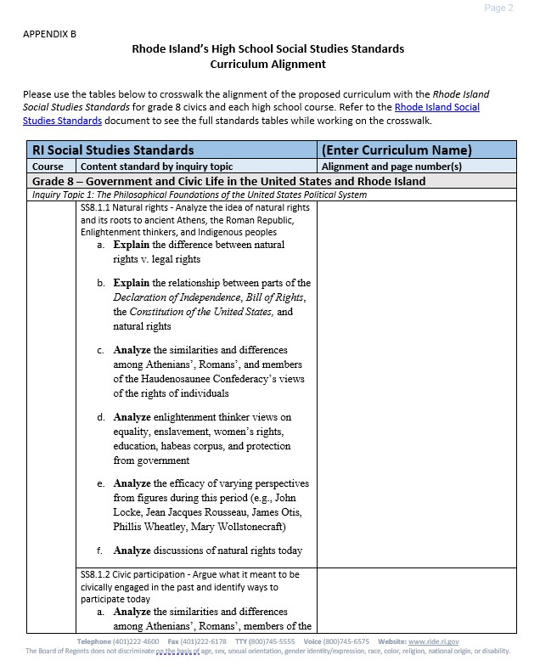
Request for Curriculum
Publishers were required to fill out a form and cross walk / correlate their curricula to the RI Standards and provide page numbers
They also had to answer questions and provide evidence (page numbers) for each grade/course such as:
How does the curriculum support student inquiry and engagement?
What supports does the curriculum provide for multilingual learners and differently abled students?
Notes:
Publishers were required to fill out a form with general information about the titles they were submitting as well as fill out a document cross walking their materials to the Social Studies Standards. In addition to correlating materials to the Standards, there are questions at the end of the document for each grade/high school course that requires publishers to provide evidence for some of the afore-mentioned high-quality criteria such as supports for Multilingual Learners (MLLs) or inquiry-based learning.
{Note: Template correlation documents for each grade and high school course are available if schools or LEAs would like to use them as tools to review materials. Please contact socialstudies@ride.ri.gov to request a zip file of these documents.}

Slide 12
Request for Curriculum
Submissions Received in Response:
Grade / Course | # of Submissions
Kindergarten | 3
Grade 1 | 3
Grade 2 | 3
Grade 3 | 3
Grade 4 | 3
Grade 5 | 4
Grade 6 | 5
Grade / Course | # of Submissions
Grade 7 | 4
Grade 8 | 4
HS Civics | 5
HS US History I | 5
HS US History II | 5
HS World History I | 6
HS World History II | 6
Notes:
This table shows how many curricular submissions RIDE received for each grade and high school course. Please note that not all existing publishers chose to participate. A few informed RIDE that they were not yet ready to align to our standards but may participate if RIDE runs a future review cycle.

Slide 13
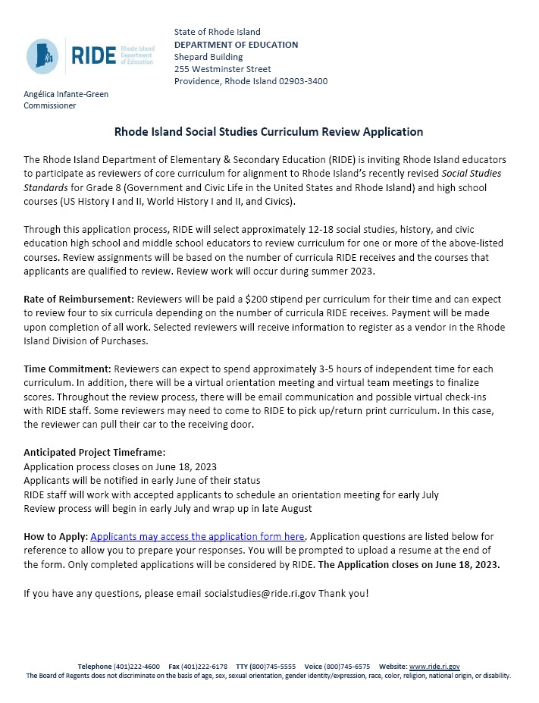
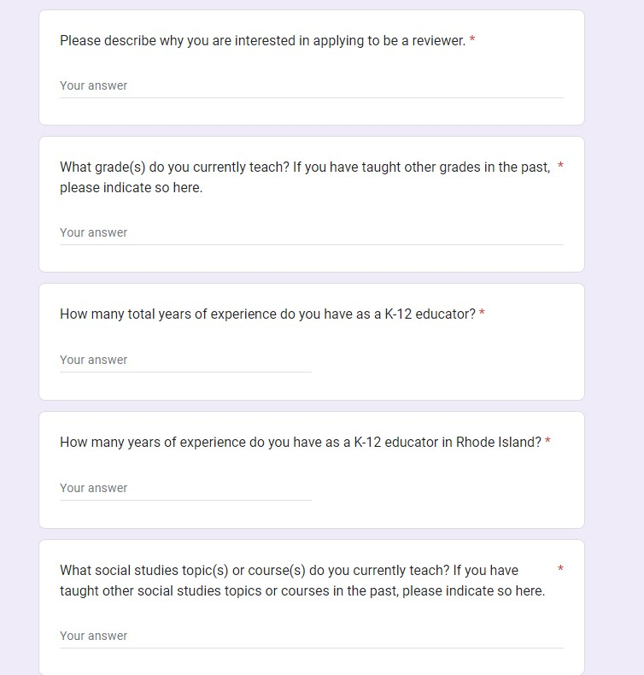
Review Team Selection
The call for applicants was posted in the Social Studies Newsletter, RIDE’s Field Memo, and RIDE’s website
Applicants filled three spots for each team
Applicants selected to ensure team members:
Represented districts around the state,
Had varying years of experience, and that
Some team members had experience with special populations
Notes:
RIDE led the recruitment, selection, and training of review team members for each of the three phases. A call for applicants was published on RIDE’s website and disseminated through the Field Memo and Social Studies Newsletter. Each team had three available positions, and applicants were selected based on several criteria: ensuring statewide district representation, including teachers with diverse levels of experience, and incorporating members with expertise in serving special populations, such as Multilingual Learners (MLLs) and Differently Abled Students (DAS).
Reviewers were also assigned to grade levels or spans aligned with their expertise. For example, high school curricula were reviewed by high school educators who currently teach or have taught the specific courses being reviewed. Middle school teachers assessed materials for their respective grades, while elementary teachers reviewed K-4 materials, with teams divided into lower, middle, and upper elementary spans.
In Phases 1 and 2, each grade level and high school course had its own dedicated review team. For instance, the grade 6 team evaluated all materials submitted for that grade. In Phase 3, due to fewer elementary submissions, RIDE organized three teams to cover the five elementary grade levels (K-4). Each team was assigned five curricular titles to review, ensuring thorough evaluation.

Slide 14
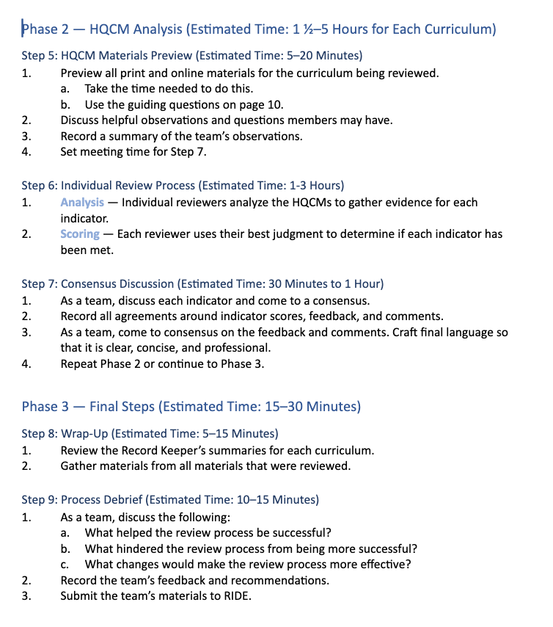
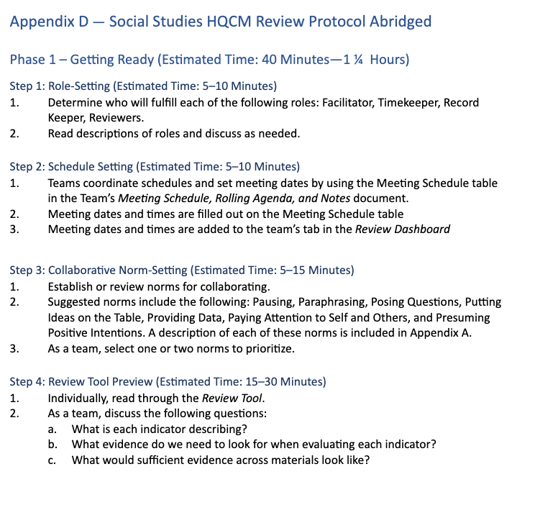
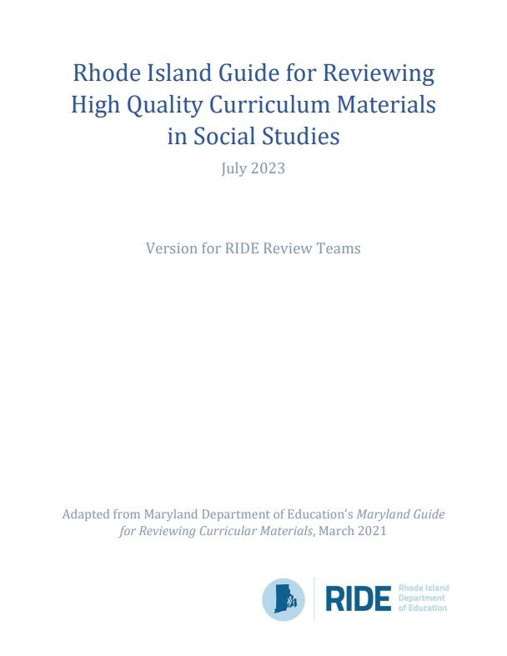
Review Protocol
Notes:
Review teams followed the protocol mentioned earlier with a few additional instructions specific to these reviews. The protocol required reviewers to look at one set of materials at a time. The protocol includes defining team roles, establishing norms, and aligning everyone's understanding of the review tool. The protocol also lays out a review cycle that teams followed.
For each set of materials, teams followed a repeated cycle. They began by previewing the materials together, then proceeded with independent review of the materials. Afterward, the team reconvened to discuss their individual findings for each criterion and to work toward a consensus. For this project, RIDE defined consensus as a majority-rules approach. However, teams were also encouraged to include descriptive feedback in their notes to capture all viewpoints. This process was repeated for each set of materials.

Slide 15
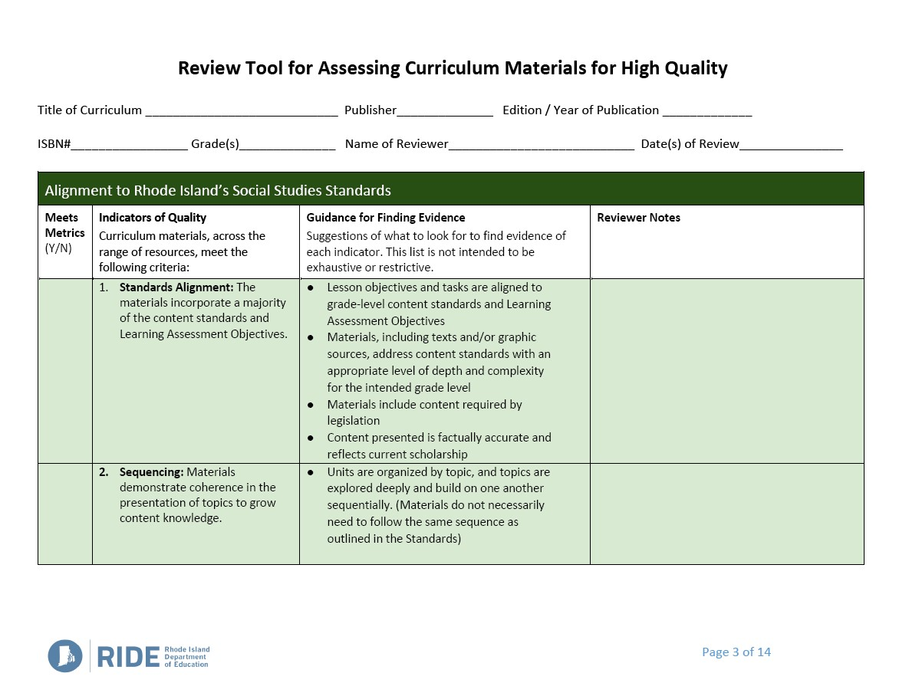
Review Team Orientation and Training
Review teams were instructed to
Review materials as if “out-of-the box”
Look for patterns
Document where they found some of the evidence
Review all of the materials in a set
Notes:
Each team went through an orientation process that included pre-work, learning about the review protocol and Review Tool, and participating in a Review Tool calibration activity.
Review teams were instructed to review the materials as they are out of the box and not base their analysis on how a teacher might adapt them.
Teams were provided with the technical reports submitted by curriculum vendors to help identify evidence related to the Review Tool criteria. However, they were directed to prioritize using the Review Tool to assess evidence within the materials themselves, rather than relying solely on the evidence presented by the publishers.
Team members were also informed that if any of them are familiar with a particular curriculum, they need to look at the materials through the lens of the Review Tool.
The Phase 1 team met during the summer of 2023 and, given summer schedules, their orientation was two-hours and virtual. Phase 2 and 3 teams met during the 2023-2024 school year and RIDE was thus able to host the orientation sessions in person for a half day on a Saturday. The longer orientation session allowed teams to start their work together previewing their first set of materials.

Slide 16
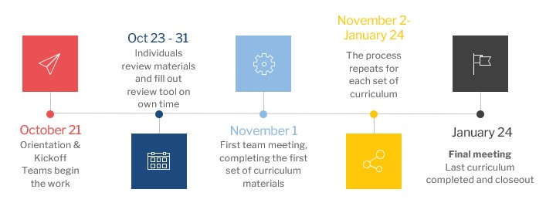
Review Team Meetings
Example meeting cycle
Notes:
This is an example, from Phase 2, of the meeting cycle for the review teams. Phase 1 teams met on their own and set their own meeting dates and times due to summer travel plans of members. Phase 2 and 3 teams were able to have regular in-person and virtual meetings and were able to keep to a regular cadence of an approximately two-week review cycle for each set of materials. Some teams also met at additional times outside of the set meetings.
RIDE organized a shared dashboard document for each phase of the work as a means for teams to track their progress and for RIDE to regularly review work, provide feedback, and ask clarifying questions.

Slide 17
Meeting Minimum Requirements
A core curriculum is considered to have met minimum requirements for consideration by LEAs if it has been determined that it meets most indicators as outlined in the first two areas of the Review Tool and has otherwise met the majority of indicators across the areas of the Review Tool.
Does not mean perfect
A core curriculum is considered to not have met minimum requirements for consideration by LEAs if it has been determined that it does not meet most indicators as outlined in the first two areas of the Review Tool or has otherwise not met the majority of indicators across the areas of the Review Tool.
Notes:
RIDE set definitions for curricula that met versus those that did not meet minimum requirements for consideration by districts. While materials deemed by review teams to meet these requirements are satisfactory, they are not flawless and may still require supplementation.
While RIDE did not design the Review Tool with "Gateway" criteria like those found in other such tools, reviewer notes revealed that the first two areas of the Review Tool were the most critical. Titles primarily needed to perform well in these areas to be considered as meeting the minimum requirements for consideration by districts. For instance, even if materials include excellent assessments, they hold little value if they fail to meet the majority of the Social Studies Standards.

Slide 18
Curricula that Meet Minimum Requirements
Grade / Course | # of Submissions | # Meet
Kindergarten | 3 | 2
Grade 1 | 3 | 2
Grade 2 | 3 | 1
Grade 3 | 3 | 1
Grade 4 | 3 | 1
Grade 5 | 4 | 2
Grade 6 | 5 | 3
Grade / Course | # of Submissions | # Meet
Grade 7 | 4 | 3
Grade 8 | 4 | 2
HS Civics | 5 | 4
HS US History I | 5 | 2
HS US History II | 5 | 2
HS World History I | 6 | 1
HS World History II | 6 | 1
Notes:
This table again shows the number of submissions for each grade and high school course, with an additional column indicating the number of titles that were determined by review teams to have met the minimum requirements.

Slide 19
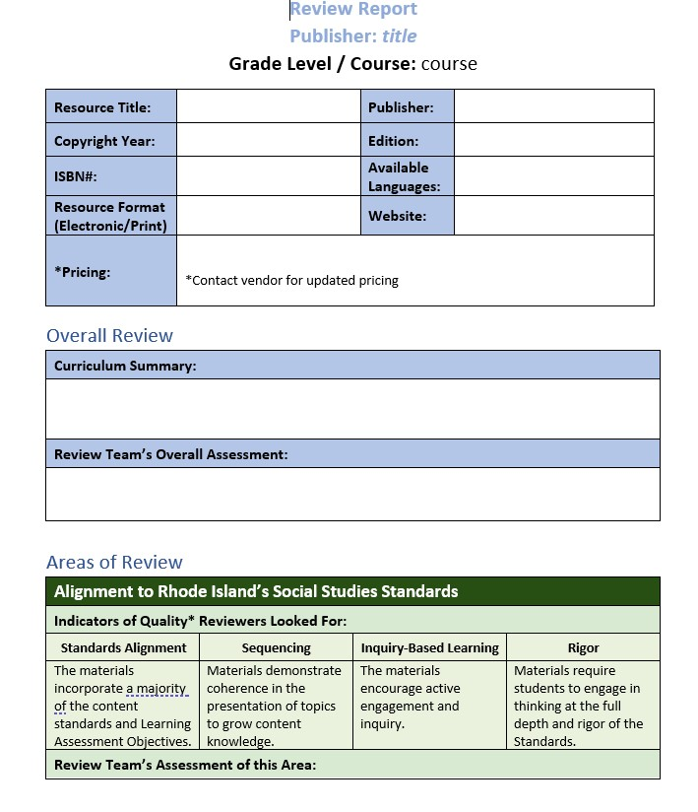
Review Report
For Titles that Met Minimum Requirements
Reports have information for each area and indicator of the review tool
Includes correlations provided by the publisher
Some have responses by the publisher
Not a hierarchy of materials (listed in alphabetical order)
Not an endorsed list of materials
Reminder: LEAs are not required to select materials that have been reviewed through RIDE’s review process
Notes:
RIDE has made full review reports available on the social studies landing page of its website for titles that meet the minimum requirements. These reports have been edited for consistency and clarity; however, variations in writing style may reflect the contributions of different review teams. While assessments such as the presence of multiple perspectives in a curriculum were not altered, technical details—like the availability of text-to-speech features in a curriculum's online platform—were reviewed by RIDE and standardized across reports.
{Note: the facilitator may wish to visit RIDE’s website to walk participants through an example report – ride.ri.gov/instruction-assessment/socialstudies click the plus sign next to “Social Studies Core Curriculum Reviews.” Each report includes a summary of the curriculum, reviews for each of the areas and indicators, and the correlations to the Standards provided by the publisher. Publishers were invited to submit a response to the report. If they did so, those were added to the end of the reports.}

Slide 20
Thank you!
RIDE Contact:
Education Specialist, Humanities and Social Studies
socialstudies@ride.ri.gov

